Slide 1
Paul Pinault
Blog/contact : www.disk91.com
Twitter : @disk_91
YouTube: https://www.youtube.com/c/PaulPinault
The Internet Of Things
Introduction to what is the Internet of Things, why does it change the world where we live, what are the technologies behind the scene ?
How des it apply to your domain ?

Slide 2
Helium is a blockchain for LoRaWan Distributed Global crowdsourced IoT Network
Author – Paul Pinault / Disk91.com

Slide 3
Helium is a blockchain for LoRaWan Distributed Global crowdsourced IoT Network
Author – Paul Pinault / Disk91.com
Coverage is provided by a community of people instead of a company. Like TheThingsNetwork

Slide 4
Helium is a blockchain for LoRaWan Distributed Global crowdsourced IoT Network
Author – Paul Pinault / Disk91.com
Investment on hardware is rewarded by a crypto token. Blockchain’s rules pilot the deployment and supports the main telecom industry processes.

Slide 5
Helium is a blockchain for LoRaWan Distributed Global crowdsourced IoT Network
Author – Paul Pinault / Disk91.com
The network is global, it has started in North America, now covering Europe quickly and start in Asia.

Slide 6
Helium is a blockchain for LoRaWan Distributed Global crowdsourced IoT Network
Author – Paul Pinault / Disk91.com
The networks supports multiple LoRa Network Servers (Routers) as private networks on top of the Gataways (Hotspot) public infrastructure.

Slide 7
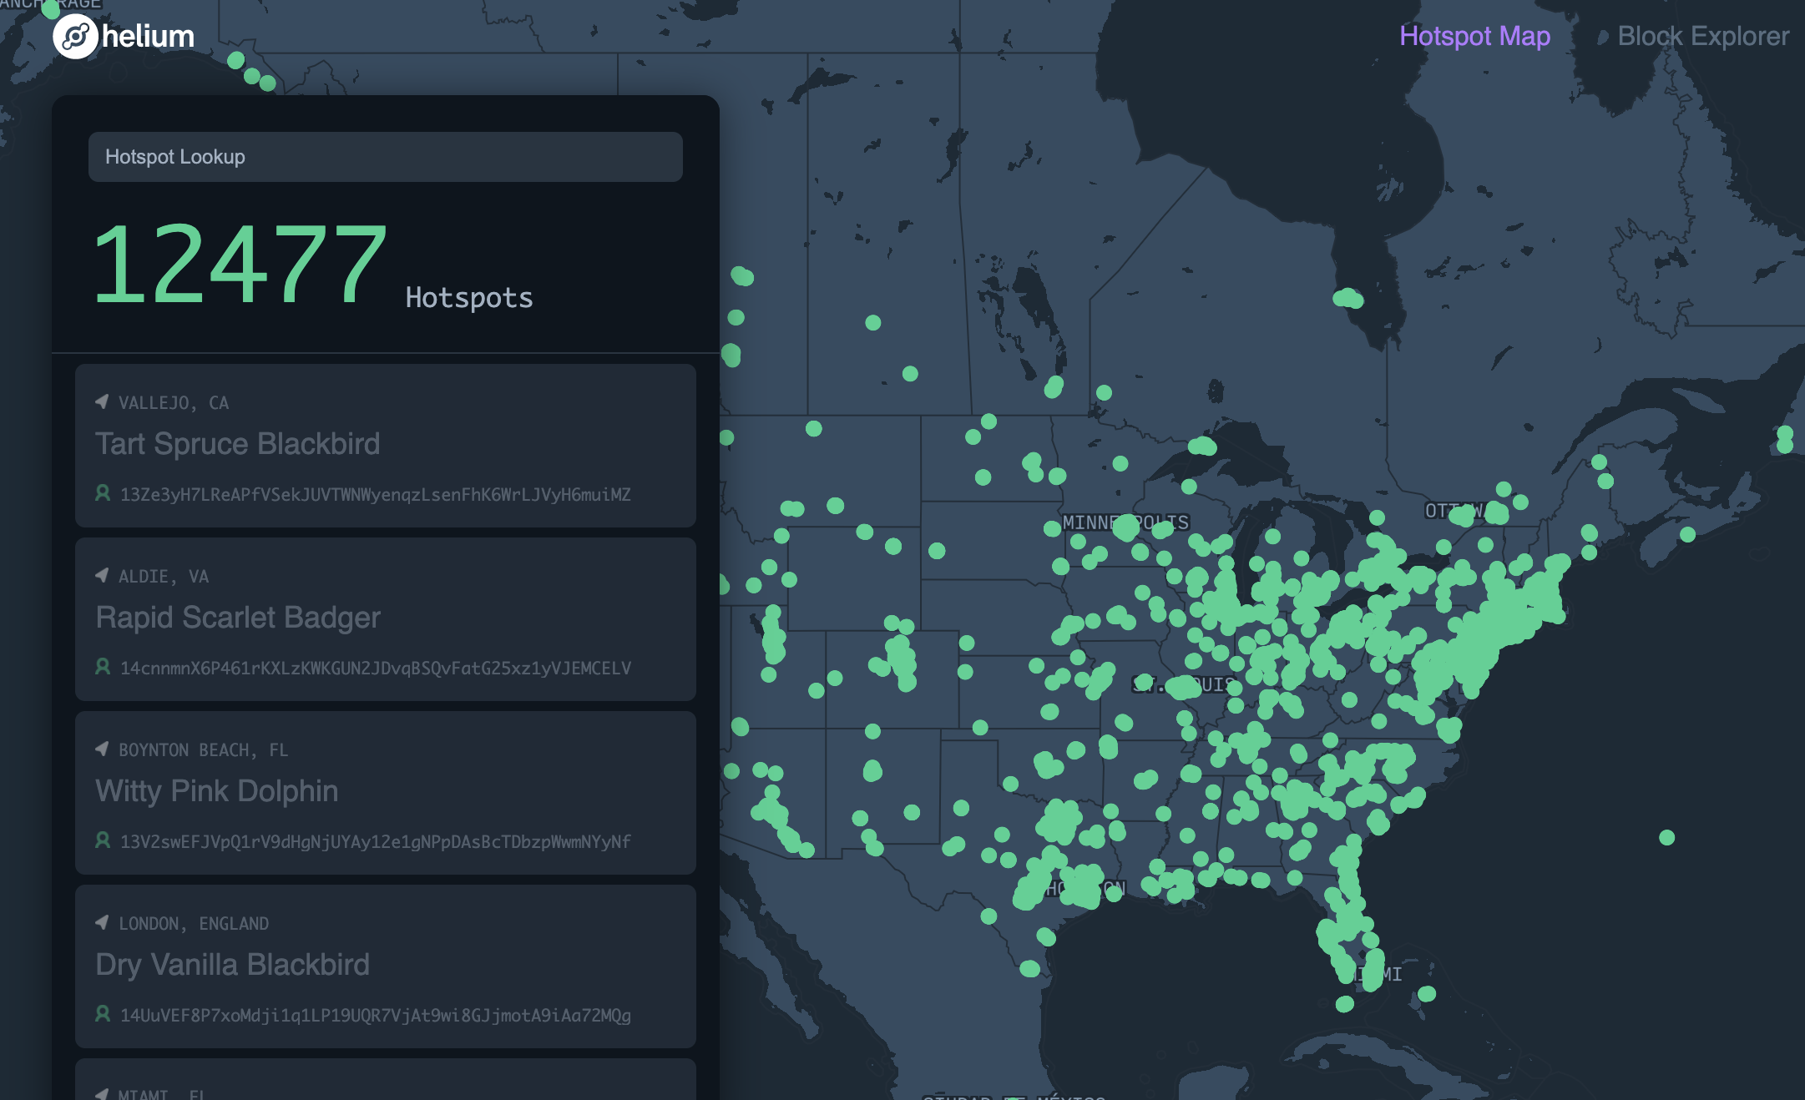
HELIUM
Is also crowdsourced IoT network, but it targets a different category of people to deploy the network. Instead of tech passionate, it target crypto investors.
Helium is an IoT network managed with a blockchain. Helium contributor are mining HNT tokens against coverage. Communication are billable with a flat and low price.
Basically, it is UBER + BITCOIN for Telecom industry
May 2020 3.025 HS
Nov 2020 12.477 HS
Feb 2021 18.700 HS
July 2021 77.100 HS
August 2021 100.000 HS
October 2021 220.000 HS
Nov. 2021 320.000 HS
Sept. 2022 954.940 HS
Feb. 2023 986.820 HS
Crowdsourced
Author – Paul Pinault / Disk91.com

Slide 8
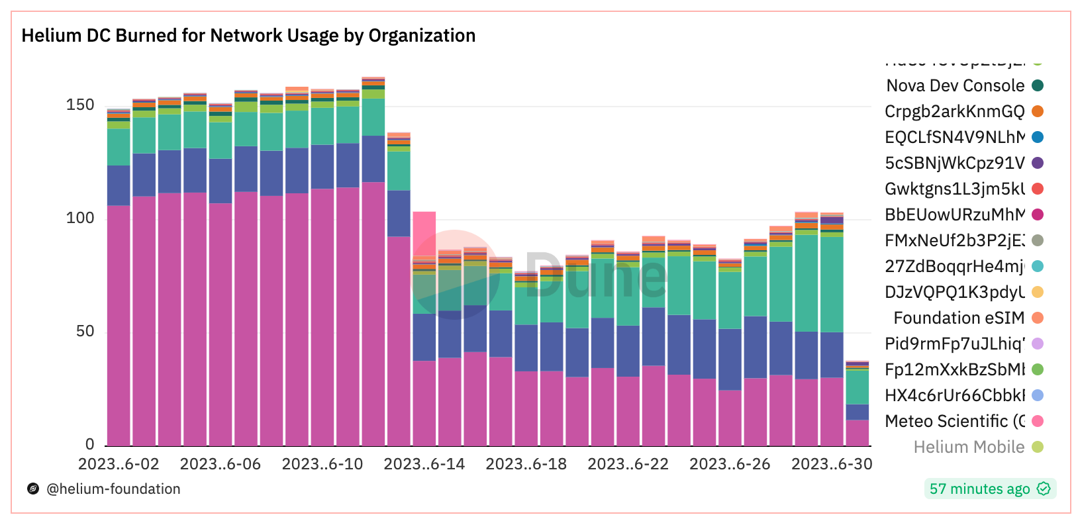
July 2023 Status
420K active hotspot in month, globally stable on the last 6 months.
Author – Paul Pinault / Disk91.com
Some mee-too blockchains try to take a part of it with Y connectors
Some big players leaves the game like bobcat
Helium BUSINESS Usage per day in $ ($1 = 100k messages eq or 24Bytes)
Main console filtered due to gaming past month (add $50)
(drop due to normal packet purchasing (duplicates evolution))
About 10M packets processes per day for business applications
As part of it 60% is roaming packets for Telcos
Hotspot have been made simpler, less need for maintenance, good stability.

Slide 9
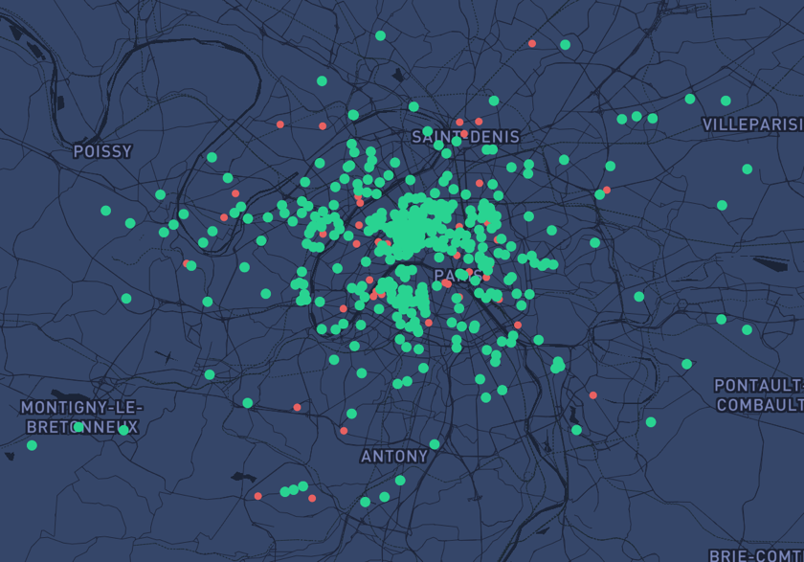
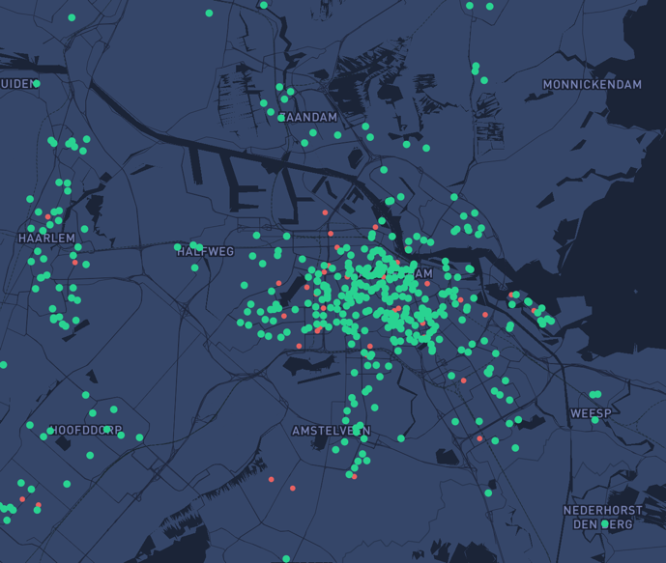
Helium is high density LoRaWan
New York
London
San Francisco
Paris
Amsterdam
Author – Paul Pinault / Disk91.com

Slide 10
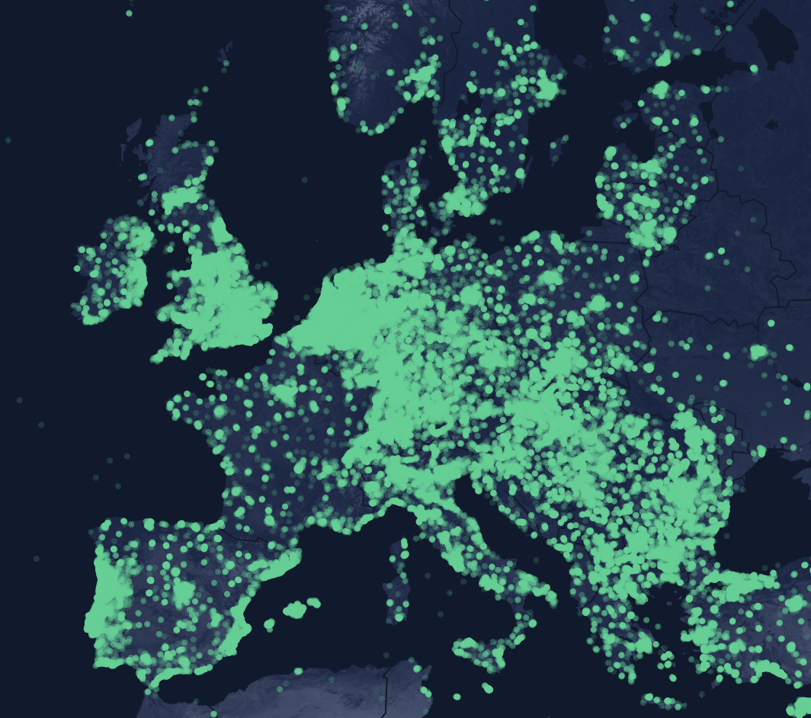
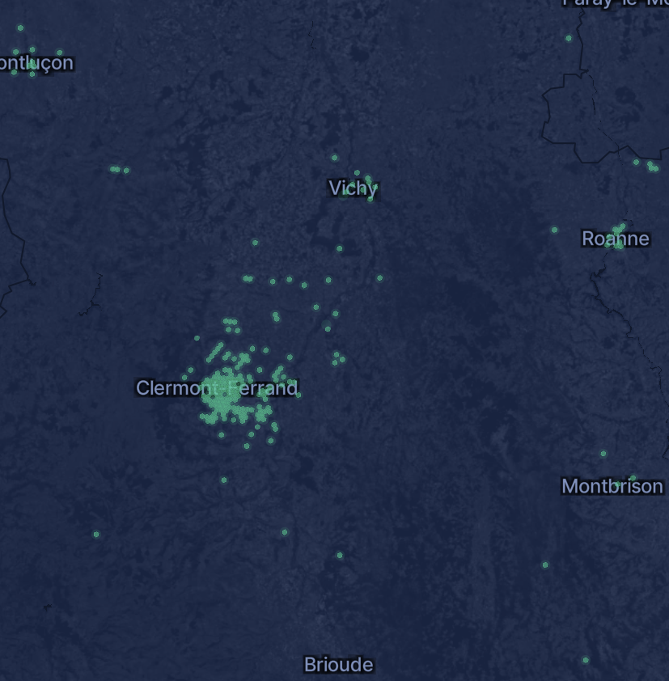
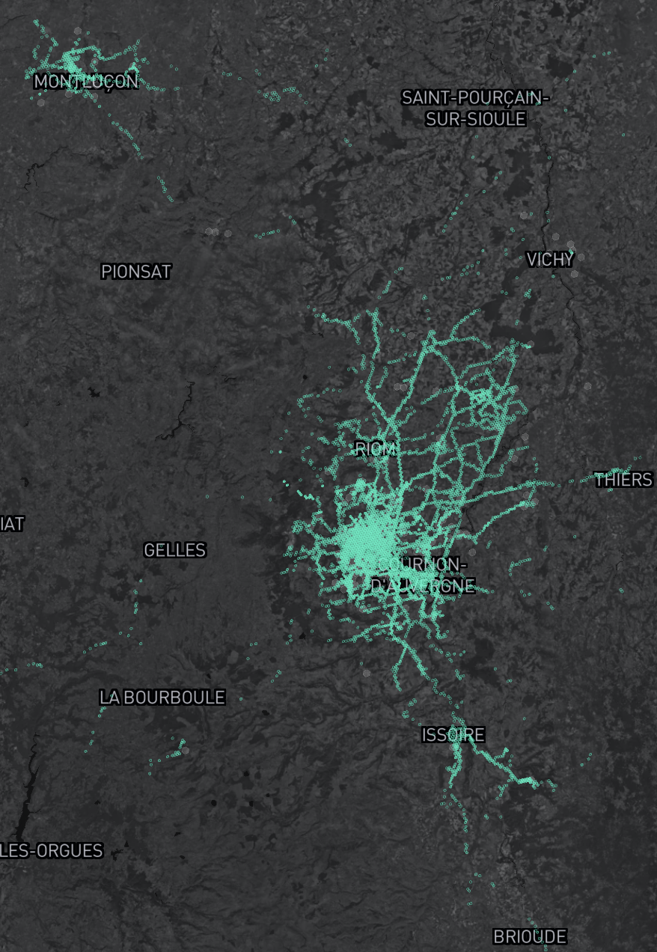
Helium at Clermont-Ferrand
EUROPE CONTEXT
CLERMONT-FD
COVERAGE MAP
Author – Paul Pinault / Disk91.com

Slide 11
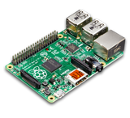
Network Architecture (before HIP 71)
Author – Paul Pinault / Disk91.com
DEVICES
HOTSPOT
P2P Network
Network Server
Application Server
Users
Distributed IoT Network
Operator
Service Provider / User
Helium distributed architecture
The HELIUM network is composed by hotspots. A Hotspot is a LoRaWan gateway associated to a Miner. A miner is lightweight and can run on a raspberry Pi. It is running in a docker container.
The miners are connected altogether over a P2P network. They are maintaining / running the blockchain.
Device communication passes through these different layers and are routed up to their specific Network Server. The distributed network supports multiple Network Servers. (Network Servers are centralized components in this architecture). Application servers works on helium as on any other Network Server. Nothing specific.
The data itself is not inside the blockchain.

Slide 12
Network Server Architecture (current)
Public LNS
Public LNS
Private LNS
Author – Paul Pinault / Disk91.com
DEVICES
HOTSPOT
ROUTING
LNS
APP SERVER
Users
Hotspot Owners
Nova Labs
Operator
Users
Helium Network Server Architecture
Helium have a geo-replicated routing infrastructure where all the hotspots push the received packets.
This infrastructure is verifying the packet, purchase it to the hotspost and route it to the right LNS.
LNS are running Chirpstack, open-source agnostic LoRaWan Server.
Devices and sessions needs to be declared in the Helium Routing service by the LNS. This requires API call to Helium Routing service (Config Service) on: Device Addition, Device Deletion, Device Session creation…
Specific open-source project has been created to support this ( see my github )

Slide 13
Routing Architecture
v
Helium
Routing
Infrastructure
LNS (OUI 1)
Helium
Config Server
Helium
GLUE
Hotspot transfers the packets to the nearest Helium router with geo-dns.
USA
Author – Paul Pinault / Disk91.com
Chirpstack or other
Router verify then transfer the packet to the LNS owning the packet
EUROPE
LNS (OUI 2)
Helium Glue configure Helium routing infrastructure to correctly verify and route the packets.
ASIA
Chirpstack or other

Slide 14
JOIN PROCESS
DEV EUI
APP EUI
APPKEY
DEV ADR
APPSKEY
NTWSKEY
Helium router is searching for a route with a corresponding DEV-EUI / APP-EUI to accept the JOIN Request.
HOTSPOT
JOIN REQUEST
Pays
Packet
Helium Routing Infrastructure
CONFIG SERVICE
SEARCH
ROUTE
PAQUET PURCHASER
Helium Glue detects device addition & deletion to maintain the Config Service database with valid DEV-EUI/APP-EUI.
Route 1:
DEV EUI / APP EUI
DEV EUI / APP EUI
Route 2:
DEV EUI / APP EUI
DEV EUI / APP EUI
…
Route n:
…
Purchase valid DEV-EUI / APP-EUI
Author – Paul Pinault / Disk91.com
Helium Glue detects session creation to maintain the list of SKF (Session Key Filters) to the config Service. Basicaly the NTWSKEY list per DEVADR
JOIN REQUEST
ADD/DEL
ROUTES
ADD/DEL
EUIS
ADD/DEL
SKFS
Helium Glue
Detect Sessions
LNS ( Chirpstack )
JOIN ACCEPT
Routes are managed by Helium Glue, can be global or per tenant. Route allows multiple LNS per OUI
Detect ADD/DEL
DEVICES
DEV-EUI
APPKEY
Detect ADD/DEL
TENANTS
LoRaWAN LNS

Slide 15
UPLINK PROCESS
DEV ADR
APPSKEY
NTWSKEY
Helium router is searching for a route with a corresponding DEV-ADR / NTWSKEY by verifying all signatures for the DEVADR.
HOTSPOT
UPLINK REQUEST
Pays
Packet
Helium Routing Infrastructure
CONFIG SERVICE
SEARCH
ROUTE
PAQUET PURCHASER
Valid packets are sent to LNS and paid to hotspots. Depends on max_copy route param, one or multiple packets are paid.
Route 1:
DEV ADR / NTWSKEY
DEV ADR / NTWSKEY
Route 2:
DEV ADR / NTWSKEY
DEV ADR / NTWSKEY
…
Route n:
…
Purchase valid DEVADR / NTWSKEY
Author – Paul Pinault / Disk91.com
Helium Glue, in public usage, manage per device / account, packet balance. When a balance is reaching 0, the Glue will deactivate routes in config service.
UPLINK
ADD/DEL
EUIS
ADD/DEL
SKFS
Helium Glue
LNS ( Chirpstack )
Count packets
& manage balance
DOWNLINK
Downlink are free of charge.
DEVADR
NTWSKEY
APPSKEY
LoRaWAN LNS

Slide 16
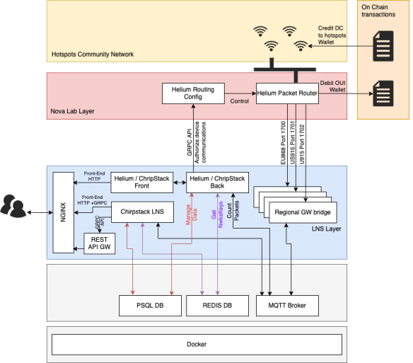
Helium GLUE
Chirpstack tenant & device creation / deletion can be found in the PSQL Database.
Session Key are maintained in REDIS Database
S3
Helium Foundation
PoC & Reward data
Author – Paul Pinault / Disk91.com
Helium ETL
Packet count & JOIN request can be detected with MQTT.
Hotspot
Lat/Long
HTTP Integration
Packet Forwarder
Helium Legacy
Payload
Chirstack
Enriched Payload
With localization
Chirpstack is per Region, not a global LNS. But we can dynamically update the region.
Downlink handler

Slide 17
Content
Slide Deck
GitHub Project
Author – Paul Pinault / Disk91.com
Youtube Channel
WWW.DISK91.COM

